Slide 1

Image: Water Source (Add image manually)
Image: Community fetching water (Add image manually)

Slide 2

Waterpoint Functionality Classification
Predicting Functional Status of Waterpoints in Tanzania
Charity Mwangangi
23nd July 2025

Slide 3

Introduction
Reliable water access is crucial for community health and development.
Many waterpoints fail and need timely maintenance.
Goal: Build machine learning models to classify waterpoints as functional or needs_attention.

Slide 4

Dataset Overview
Waterpoint data with multiple features (e.g., location, age, water amount).
Target classes: functional, needs_attention.
Challenges: Imbalanced classes, Features on different scales.

Slide 5
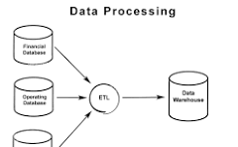
Data Preprocessing
Log-transformed skewed features like amount_tsh and population.
Standardized numerical features using StandardScaler to normalize scales.
Split into training and validation sets.

Slide 6

Modeling Approach
Developed and compared three base models:
1. Logistic Regression
2. Decision Tree Classifier
3. Random Forest Classifier
Evaluated based on accuracy, precision, recall, and F1-score.
Tuned Random Forest with class weights for balance.

Slide 7

Logistic Regression
Accuracy: ~77.5%.
Precision for 'needs_attention': 0.80.
Recall for 'needs_attention': 0.68 (misses 32% failing wells).
Strength: Good at identifying functional wells.

Slide 8

Decision Tree
Accuracy: ~77.0%.
Recall for 'functional': 0.87.
Recall for 'needs_attention': 0.64 (misses 36%).
Slight overfitting to majority class observed.

Slide 9
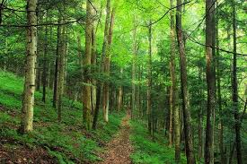
Random Forest
Accuracy: ~81.9%.
Balanced precision and recall for both classes.
Recall for 'needs_attention': 0.77 (improved detection).
Most robust and reliable base model.

Slide 10
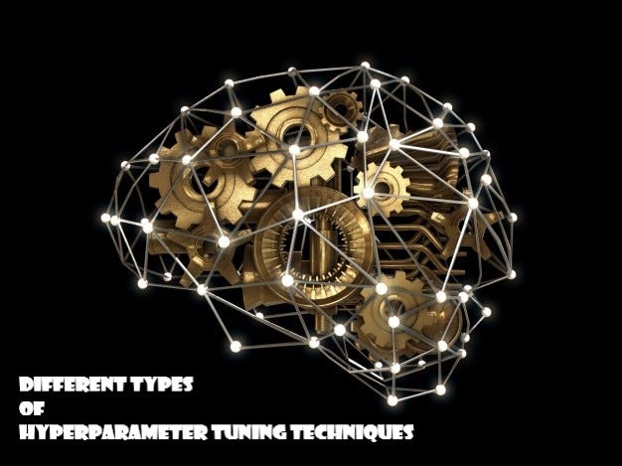
Hyperparameter Tuning
Applied class_weight='balanced' to Random Forest.
Final accuracy: ~82%.
Balanced precision (0.82) and recall (0.77) for 'needs_attention'.
Improved detection of failing wells.

Slide 11
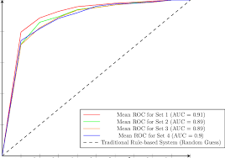
ROC Curve & AUC
AUC score: 0.88.
Indicates strong model discrimination ability.
Visualization: ROC curve shows true positive rate vs false positive rate.

Slide 12

Recommendations
Deploy Random Forest model for practical waterpoint monitoring.
Regularly retrain the model with new data to improve accuracy.
Investigate false positives carefully to avoid unnecessary maintenance.
Use model predictions to prioritize inspections and repairs.

Slide 13

Conclusion
Machine learning can effectively classify waterpoint status.
Random Forest provided best balance of accuracy and recall.
Supports proactive maintenance and better resource allocation.
Future work: Incorporate more features, explore ensemble methods, deploy in field.

Slide 14

Thank You!
Questions?
Contact: Charity Mwangangi.

